Slide 1
The Attack and Defense of Computers
Dr. 許 富 皓

Slide 2
Name Service

Slide 3
Name Service
In the early days of the Internet. A single /etc/hosts file contained the IP address and host name of each computer on the Internet; however, as the population of the Internet community increases dramatically, maintaining an accurate /etc/hosts file has gradually become an impossible mission.
# /etc/hosts
#
192.42.0.1 server
192.42.0.2 art
192.42.0.3 science sci
192.42.0.4 engineering eng
Solution: a distributed networked-based naming service called the Domain Name Service (DNS).
a second name, or alias

Slide 4
DNS & DNS Exploitation

Slide 5
Domain Name System (DNS)
A lookup mechanism for translating hostnames into IP addresses and vice-versa.
DNS provides the naming standard for IP-based networks.
A globally distributed, loosely coherent, scalable, reliable, dynamic database.
Comprised of three components:
  A “name space” (domain)
  Servers (name servers) making that name space available.
  Resolvers (clients) which query the servers about the name space.

Slide 6
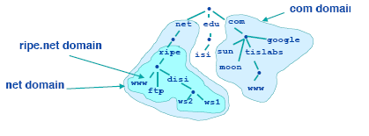
Domain
Domains are “namespaces”
Everything below .com is in the com domain.
Everything below ripe.net is in the ripe.net domain and in the net domain.

Slide 7
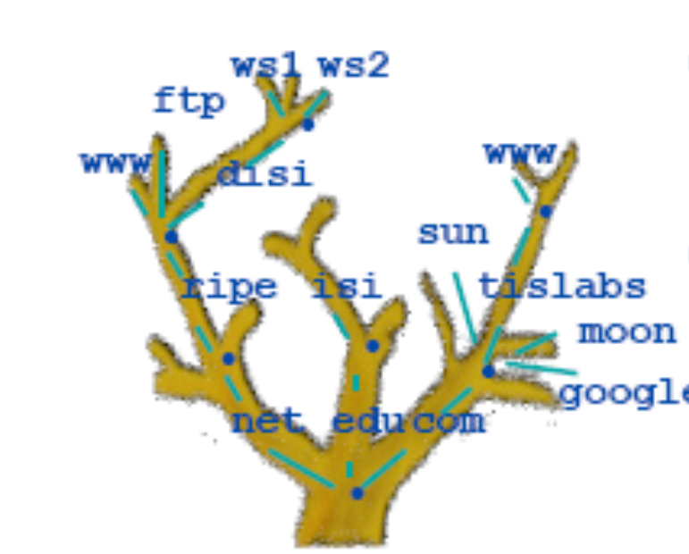
Domain Names
Domain names can be mapped to a tree.
New branches at the ‘dots.’
No restriction to the amount of branches.

Slide 8
Structure of the Domain Space – Top Level Domains
Immediately below the root is the Top Level Domains.
  These consist of country specific Top Level Domain (ccTLDs),
  and generic Top Level Domains (gTLDs).
CCNSO and GNSO decides the contents of ccTLDs and gTLDs respectively.

Slide 9
Structure of the Domain Space – Second Level Domains
Below these domains, you have the second level domain names.
  These domain names are usually "delegated" by the administrators of the relevant TLD which means that someone else is responsible for administering that part of the name space (e.g. the administrators of .ie delegated the domain linux.ie to the Irish Linux Users Group, which means that ILUG are now responsible for administering the domain in any way they see fit without reference to the administrators of .ie).
  Once a domain is delegated, the administrators of the domain are responsible for making changes within that domain.

Slide 10
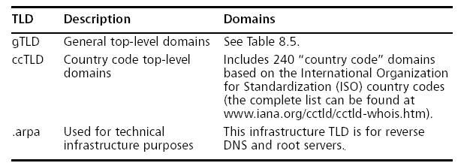
Top Level Domain (TLD) Types

Slide 11
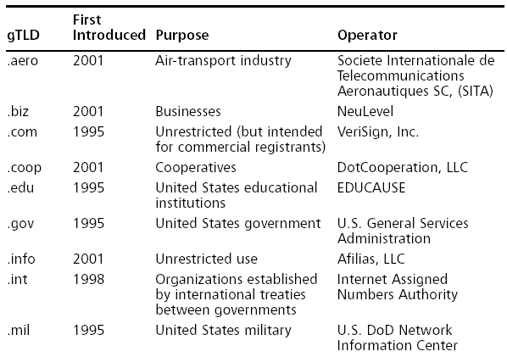
General TLDs (1)

Slide 12

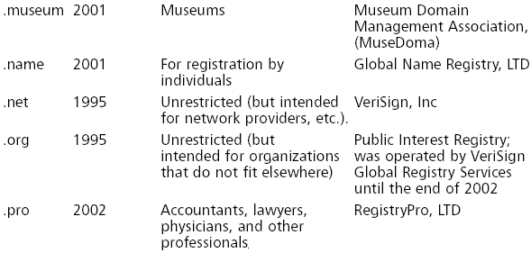
General TLDs (2)

Slide 13
DNS Servers And Their Layout
The DNS consists of a hierarchical set of DNS servers.
Each domain or subdomain has one or more authoritative DNS servers that publish information about
  that domain, and
  the name servers of any domains "beneath" it.
The hierarchy of authoritative DNS servers matches the hierarchy of domains.
At the top of the hierarchy stand the root servers: the servers to query when looking up (resolving) a top-level domain name.

Slide 14
General DNS Server Categories
Server Type Definition
Root Any server that acts as a central lookup for
other server to depend on, and does not rely
on other servers for Name Server zone
information
Authoritative Any server that
hosts domains and
returns zone information publicly
Resolver A server that performs domain queries for
end users but does not host domains or zone
information

Slide 15
Global Root Servers A ~ F
Root
Server Operated By Physical Location IP Address
A VeriSign Global Registry Herndon VA, U.S. 198.41.0.4
Services
B Information Sciences Marina Del Rey CA, U.S. 128.9.0.107
Institute
C Cogent Communications Herndon VA, U.S. 192.33.4.12
D University of Maryland College Park MD, U.S. 128.8.10.90
E NASA Ames Research Mountain View CA, U.S. 192.203.230.10
Center
F Internet Software Palo Alto CA, U.S.; IPv4:
Consortium San Francisco CA, U.S. 192.5.5.241
IPv6:
2001:500::1035
Continued

Slide 16
Global Root Servers G ~ M
Root
Server Operated By Physical Location IP Address
G U.S. DOD Network Vienna VA, U.S. 192.112.36.4
Information Center
H U.S. Army Research Lab Aberdeen MD, U.S. IPv4:
128.63.2.53
IPv6:
2001:500:1::803f:235
I Autonomica Stockholm, Sweden 192.36.148.17
J VeriSign Global Registry Herndon VA, U.S. 192.58.128.30
Services
K Reseaux IP Europeens - London, UK 193.0.14.129
Network Coordination
Centre
L Internet Corporation for Los Angeles CA, U.S. 198.32.64.12
Assigned Names and
Numbers
M WIDE Project Tokyo, Japan 202.12.27.33

Slide 17
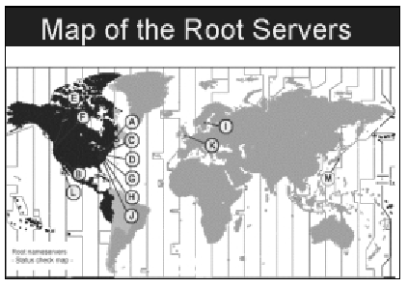
Global Root Servers’ Physical Locations

Slide 18
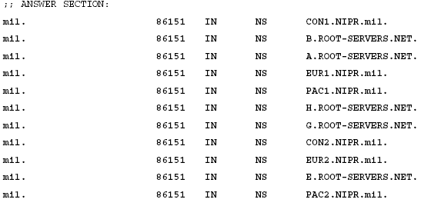
.mil Portion of a Global Root Server’s Contents(1)

Slide 19
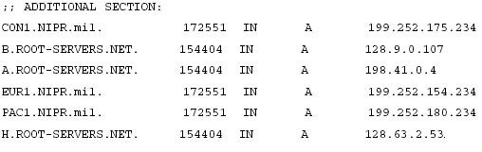
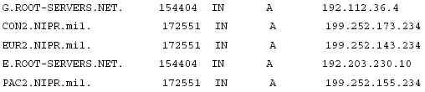
.mil Portion of a Global Root Server’s Contents(2)

Slide 20
Zone Files
Domain name information is stored in flat text files called zone files. User requests and server replies are simple text-file searches and take very few system resources.
Some newer DNS technologies allow for write access to update record data and other configurations remotely.

Slide 21
Authority And Records
The server with authority is the trusted server based on the chain of trust delegated from root servers.
Zone records are the different types of information each domain can hold.

Slide 22
Common Zone Records
Record Symbol Record Meaning Explanation
NS Name server This record will return the name of the
authoritative server for the requested domain.
SOA Start of authority This record gives information about the zone,
such as administrator contact, and various
timeouts and intervals.
PTR Pointer records This record associates an IP address with a
canonical name (normally used for reverse DNS
records).
A IP address This assigns an IP address to a host or canonical
name.
CNAME Canonical name This returns a host or canonical name.
TXT Text Displays possible comments about the requested
domain.
AAAA IPv6 Similar to an A record but returns the IPv6
address of the requested domain.

Slide 23
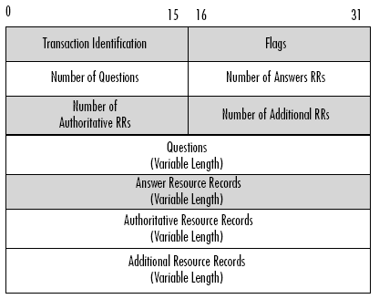
Normal DNS Packet Format Overview

Slide 24
Fields of a Normal DNS Packet
Transaction Identification
  Random number used to match client queries with name server responses
Number of Questions
  The amount of DNS queries in the packet
Number of Answer RRs
  Amount of non-authoritative DNS responses in the packet payload
Number of Authoritative RRs
  Amount of authoritative DNS responses in the packet payload
Number of Additional RRs
  Amount of other DNS responses in the packet (normally contains other DNS servers in the domain)
Questions and Answer Fields
  DNS queries and DNS server responses

Slide 25
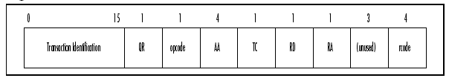
Flag Field Overview

Slide 26
Detailed DNS Packet Flag Field
The Flags field of a DNS packet is the most crucial part of the packet. It contains the control and query information regarding the packet.
  QR 0 = Query, 1 = Response
  opcode 0 = standard query, 1 = inverse query, 2 = status request
  AA Authoritative answer
  TC Truncated DNS packet
  RD Recursion desired
  RA Recursion available
  rcode (return code) 0 = no error, 1 = name error

Slide 27
DNS Implementation
DNS is implemented by a large-scale distributed database which consists of many name servers.
The name servers perform their functions by using the network to resolve each part of the hostname distinctly.

Slide 28
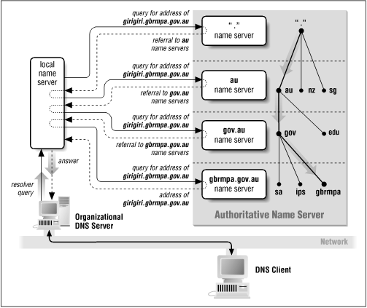
Domain Name Service Example
root domain server

Slide 29
DNS under Unix (1)
The standard UNIX implementation of DNS is called bind and was originally written at the University of California at Berkeley.
This implementation is based on three parts: a library for the client side, and two programs for the server.
DNS is based on UDP, but can also use a TCP connection for some operations.

Slide 30
DNS under Unix (2)
Resolver
  The resolver library uses DNS to implement the gethostbyname() and gethostbyaddress() library calls. It is linked into any program that needs to perform name resolution using DNS. The first time that a program linked with the resolver attempts to resolve a hostname, the library reads the /etc/resolv.conf file to determine the IP address of the nameserver to be used for name resolution. The resolv.conf file can also contain the program's default domain, which is used to resolve unqualified hostnames (such as girigiri, as opposed to girigiri.gbrmpa.gov.au).

Slide 31
DNS under Unix (3)
named (or in.named)
  The named daemon is the program which implements the server side of the DNS system. When named is started, it reads a boot file (usually /etc/named.boot) that directs the program to the location of its auxiliary files. These files then initialize the named daemon with the location of the root domain servers. If the named daemon is the nameserver for a domain or a subdomain (which is usually the case), the configuration file instructs the program to read in the domain's host tables or get them from a "master" server.

Slide 32
DNS under Unix (4)
named-xfer
  Program used to transfer zones from primary to secondary servers. This program is usually installed as /etc/named-xfer. It is run by the secondary server to perform a zone transfer. The named-xfer program connects to the named program running on the primary server and performs the transfer using TCP.

Slide 33
A Hazard with Domain Registration
Arises from how some registrars allow updates.
  For example:
    The current Network Solutions implementation allows automated online changes to domain information.
    Network Solution authenticates the domain registrant’s identity through Guardian method, which uses three different types of authentication methods.
      The FROM field in an e-mail (weakest one and could be forged easily.)
      A password.
      A Pretty Good Privacy (PGP) key.
Domain Hijacking -- AOL example
  Someone pretended to be an AOL official and changed AOL’s domain information so that all traffic was directed to autonete.net.

Slide 34
DNS Query Utilities

Slide 35
dig
A utility that can query the DNS to get IP-related or domain-related information.

Slide 36
Syntax of dig Utility _{[Rick],[Kloth]}
dig [@Server][query-type][name]
  Server is the name or IP address of the name server to query.
  Note that the name argument will take on different forms depending upon the type of query;
    it might have to be a bare domain name in some cases,
    while it might have to be a host name in others;
    in the case of the PTR lookup, name will be the IP address rendered in a special form.

Slide 37
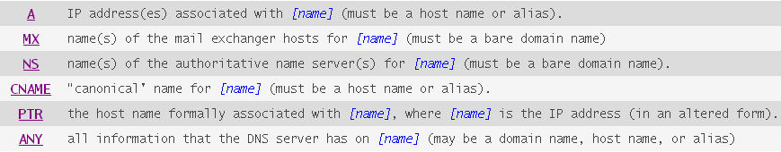
Syntax of dig Utility
dig [@Server][query-type][name]
  The [query-type] we'll be looking at include:

Slide 38
Output Format of dig
dig splits a DNS packet into 4 sections.
  QUESTION SECTION
  ANSWER SECTION
  AUTHORITY SECTION
  ADDITIONAL SECTION

Slide 39
Find the IP Address of a Host

Slide 40
dig Examples — Find the IP Address of a Host (1)
dig www.cs.berkeley.edu
# dig www.cs.berkeley.edu
; <<>> DiG 9.1.3 <<>> www.cs.berkeley.edu
;; global options: printcmd
;; Got answer:
;; ->>HEADER<<- opcode: QUERY, status: NOERROR, id: 6382
;; flags: qr rd ra; QUERY: 1, ANSWER: 2, AUTHORITY: 6, ADDITIONAL: 4
The QUESTION SECTION displays the initial user query:
;; QUESTION SECTION:
;www.cs.berkeley.edu. IN A

Slide 41
dig Examples — Find the IP Address of a Host (2)
The ANSWER SECTION displays what server was contacted
for the answer:
;; ANSWER SECTION:
www.cs.berkeley.edu. 86400 IN CNAME hyperion.cs.berkeley.edu.
hyperion.cs.berkeley.edu. 86400 IN A 169.229.60.105
The AUTHORITY SECTION lists the servers in charge of
cs.berkeley.edu:
;; AUTHORITY SECTION:
cs.berkeley.edu. 86400 IN NS ns.cs.berkeley.edu.
cs.berkeley.edu. 86400 IN NS ns.EECS.berkeley.edu.
cs.berkeley.edu. 86400 IN NS cgl.UCSF.edu.
cs.berkeley.edu. 86400 IN NS ns1.berkeley.edu.
cs.berkeley.edu. 86400 IN NS ns2.berkeley.edu.
cs.berkeley.edu. 86400 IN NS vangogh.cs.berkeley.edu.

Slide 42
dig Examples — Find the IP Address of a Host (3)
The ADDITIONAL SECTION displays the IP addresses of
the AUTHORITY servers:
;; ADDITIONAL SECTION:
ns.cs.berkeley.edu. 86400 IN A 169.229.60.61
ns.EECS.berkeley.edu. 86400 IN A 128.32.244.25
cgl.UCSF.edu. 86400 IN A 128.218.27.20
vangogh.cs.berkeley.edu. 86400 IN A 128.32.112.208
;; Query time: 21 msec
;; SERVER: 127.0.0.1#53(0.0.0.0)
;; WHEN: Sun Nov 24 01:01:01 2003
;; MSG SIZE rcvd: 260

Slide 43
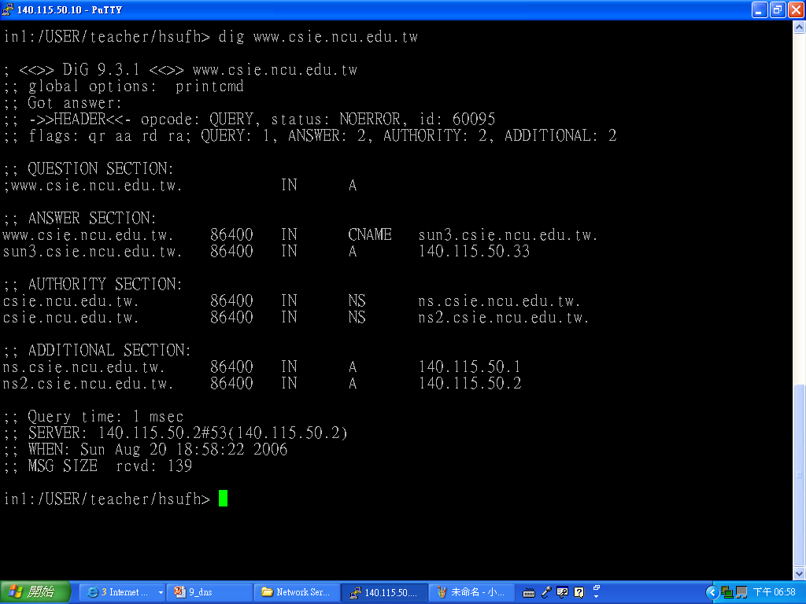
dig Example – Find the IP Address of another Host
Get the IP address of the specified host.

Slide 44
Find the Name Servers of a Domain

Slide 45
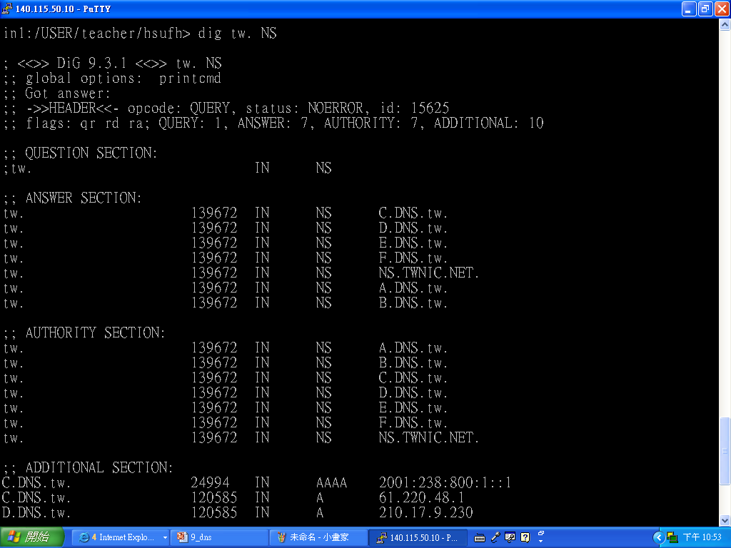
dig Examples — Find the Name Servers of tw Domain (1)

Slide 46
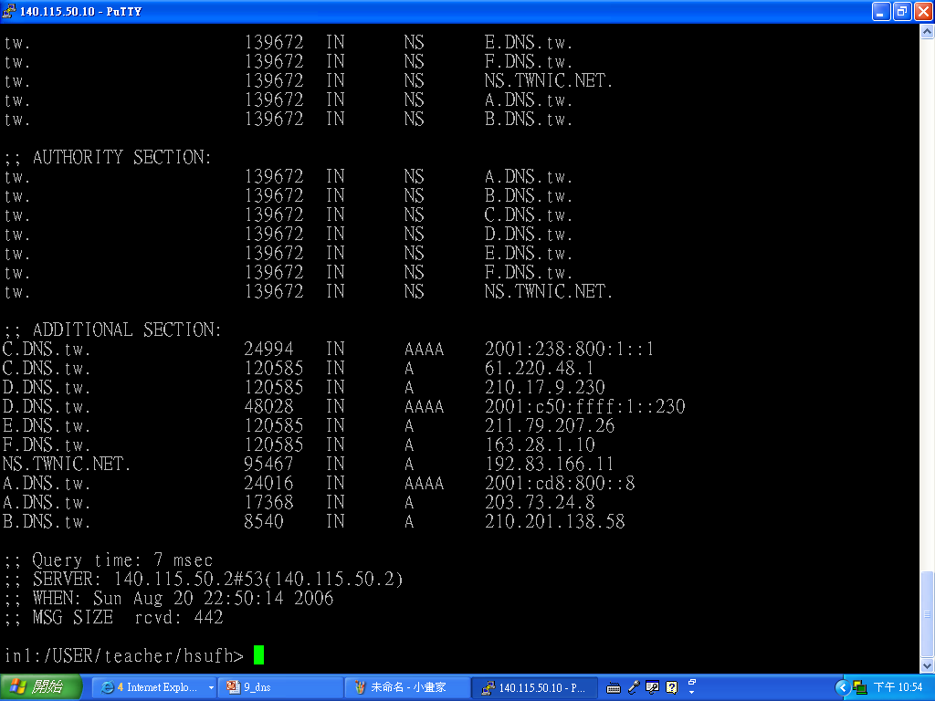
dig Examples — Find the Name Servers of tw Domain (2)

Slide 47
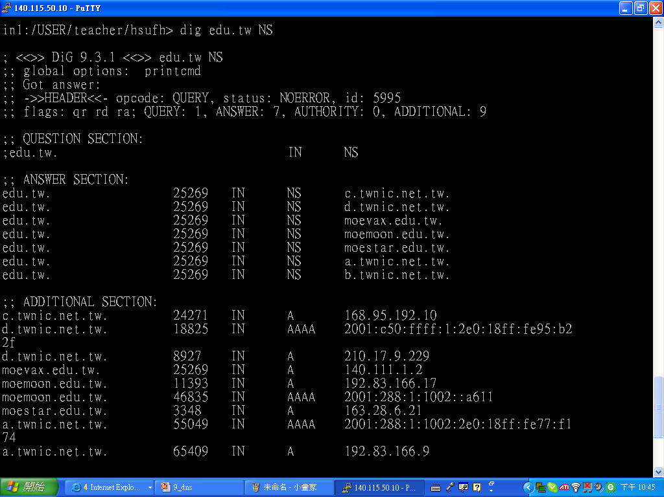
dig Examples — Find the Name Servers of edu.tw Domain

Slide 48
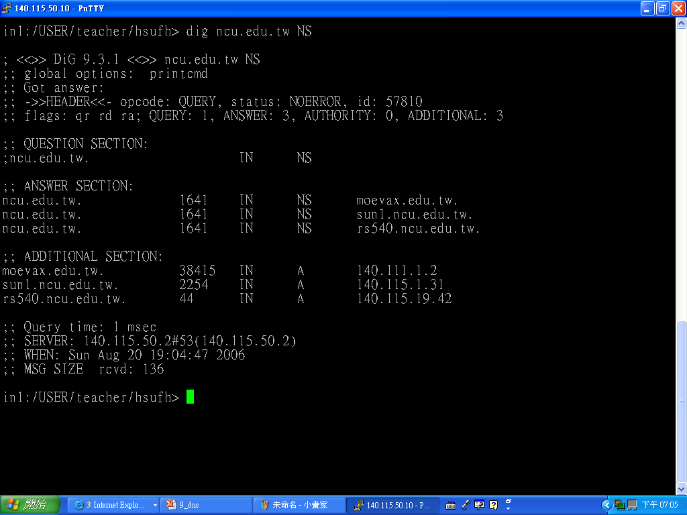
dig Examples — Find the Name Servers of ncu.edu.tw Domain

Slide 49
Find the Mail Servers
with a Specific Domain Name

Slide 50
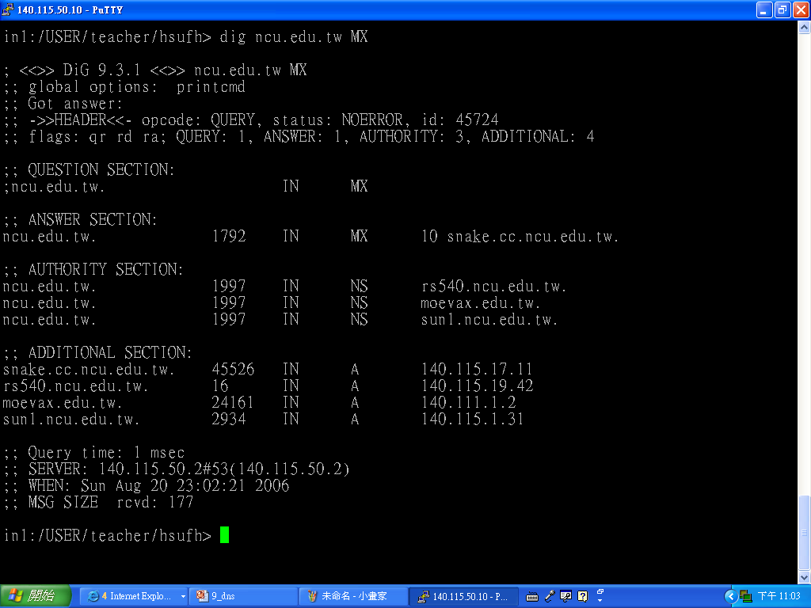
Find the Mail Servers with ncu.edu.tw Domain Name

Slide 51
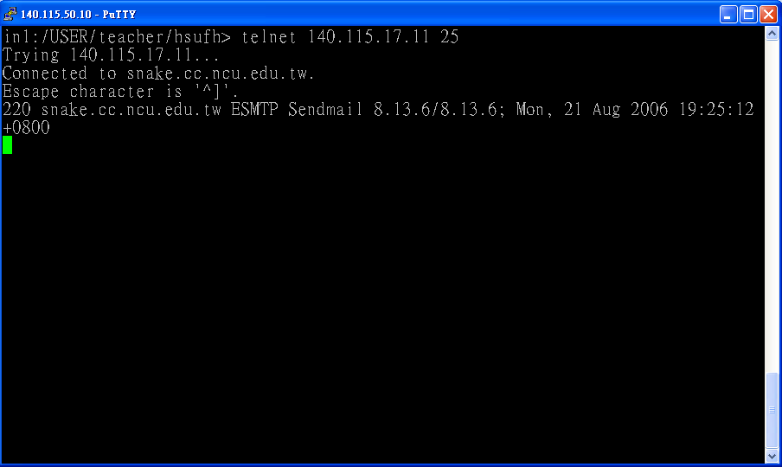
Contact a Mail Server

Slide 52
How A DNS Query Is Handled?
Command “dig www.example.com +short” is in fact handled by the following steps:
  (1) Check local DNS server’s root.cache which contains a list of the root servers.
  (2) # dig @a.root-servers.net www.example.com
  (3) # dig @a.gtld-servers.net www.example.com
  (4) # dig @a.iana-servers.net www.example.com

Slide 53
DNS Traffic
DNS traffic uses port 53 via either the User Datagram Protocol (UDP) or Transmission Control Protocol (TCP).
Normal queries will use UDP.
TCP is preferred for large packets. The historical maximum guarantee for unfragmentable packets on a network has been 576 bytes.
Zone transfers and abnormally large queries are the only time TCP is used.

Slide 54
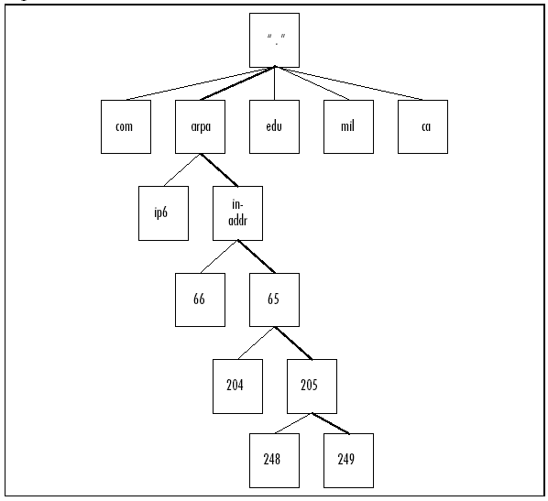
Reverse DNS Authoritative Hierarchy

Slide 55
Reverse DNS Lookup
For 65.205.249.60, you would look up 60.249.205.65.in-addr.arpa.

Slide 56
Reverse DNS Usage
Identification.
traceroute and ping both depend on reverse DNS lookups to display additional information about hosts.

Slide 57
DNS Attacks

Slide 58
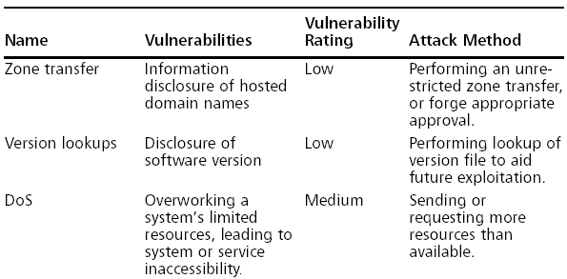
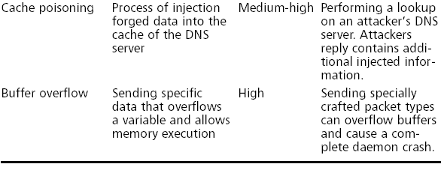
DNS Attacks

Slide 59
DNS Interrogation
One of the most serious misconfigurations a system administrator can make is allowing untrusted Internet users to perform a DNS zone transfer.
A zone transfer allows a secondary master server to update its zone database from the primary master. This provides for redundancy when running DNS, should the primary name server become unavailable.
Generally, a DNS zone transfer needs to be performed only by secondary master DNS server. However, many DNS servers are misconfigured and provide a copy of the zone to anyone who asks.

Slide 60
What Problems Could A Non-appropriate Zone Transfer Create?
The IP addresses and host names of an organization’s all computers may be exposed to the public, which is akin to providing a complete blueprint, or roadmap, of an organization’s internal network.
Many records that include names such as vpn or mssql can help an attacker identify specific targets and internal network addresses without a large detectable footprint.

Slide 61
Method to Perform Zone Transfer
Nslookup _{[Windowsnetworking]}
  Based on the content of /etc/resolv.conf, nslookup search the corresponding local DNS servers.
    “>” is nslookup’s prompt.
    The Primary domain server for the target domain is found through the steps listed in previous slides.
    Setting the record type to any allows us to pull any records available for a complete list.
    ls option’s -d switch is used to list all records for the domain.

Slide 62
Results of The Previous nslookup
If the DNS server doesn’t allow Zone Transfer, you may not get the results.
  The “A” record in each entry means that the IP address of the system name is located to its right side.
  The “HINFO” record in each entry identifies the platform or type of OS running (one of attackers’ target information).

Slide 63
Auxiliary Tools (1)
The result file can be further analyzed to get more information by using tools as grep, sed, awk, or perl.
e.g.
[bash]$ grep –I solaris zone_out | wc –l
388
means that we have 388 potential records that reference the word “Solaris.” If an attacker try to attack Solaris system, then above results mean that she/he may have 388 potential targets.

Slide 64
Auxiliary Tools (2)
Test systems usually are attackers’ favorite targets, because they normally don’t have many security features enable, often have easily guessed passwords, and administrators tend not to notice or care who logs in to them.

Slide 65
A Few Points to Notice
The aforementioned method queries only one nameserver at a time. This means you would have to perform the same tasks for all nameservers that are authoritative for the target domain.
If the target domain has several subdomains (for example, greenhouse.tellurian.net), we would have to perform the same type of query for each of them.
You may receive a message stating that cant’ list the domain or that the query was refused. This usually means the Zone Transfer is not allowed in the target nameserver; however, if there are other DNS servers, you can try all of them, and maybe get a different result.

Slide 66
Using dig to Execute Zone Transfer
dig @ns1.example.com example.net axfr

Slide 67
Version Discovery
Discovering software versions helps attackers profile a server.
Version lookups are commonly overlooked information disclosure vulnerabilities.
[root@specialops]# dig @ns1.example.com version.bind CHAOS txt

Slide 68
DNS Cache Poisoning

Slide 69
DNS Cache Poisoning
DNS cache poisoning relates to an attack consisting of making a DNS server cache false information: usually, a wrong record that will map a name to a “wrong” IP address.

Slide 70
DNS ID Hacking and the Transaction Identification Number (TIN)
If an attacker can forge an DNS reply to a name server X, then the attacker can cheat X to map a hostname to an different IP address selected by the attacker; thus redirect the traffic to the host chosen by the attacker.
The Transaction Identification number of a DNS reply must match its corresponding DNS query’s Transaction Identification number; otherwise, the host sending the DNS query will drop the DNS reply.
Due to the above reason, in order to forge a DNS reply, an attacker must use the correct Transaction Identification number. There are several different methods an attacker can use to get/guess the Transaction Identification number (see the following slides).

Slide 71
DNS ID Hacking – Blind Guesses
Flood the DNS server to buy some more time for trying different ID numbers. The hacker can even hope it will crash the server.
Send a few hundred replies at the same time to increase his chances to find the good ID. The hacker can do that several times one after the other with different ranges until the server replies.

Slide 72
DNS ID Hacking – Fixed TIN Change Pattern
Use a vulnerability in the server, knowing that some of them just increase the ID number from one request to another. This works in a server-server dialog (The “client” in our last figure is a DNS server, and the hacker is trying to poison its cache). In that case, the hacker can first make a request to the “client” using a host name in a zone controlled by the hacker, and sniff the ID used by the victim DNS server.

Slide 73
Get the TIN of Target NS with a Fixed TIN Change Pattern
The attacker gets target NS’s transaction number from this query
1.IP of a host in domain attacker.com
2. DNS query
DNS server for domain attacker.com
4.IP of a host in domain victim.com
Target NS
3.DNS reply
Attacker
5. DNS query
6. forged DNS reply
DNS server for domain victim.com

Slide 74
Birthday Attack _{[Joe Stewart]}

Slide 75
Reducing the Number of Forged Replies Sent through a Flaw in BIND
To perform attack shown in the slide “DNS ID Hacking – Blind Guesses,” one needs to send a sufficient number of queries to a vulnerable nameserver, while sending an equal number of phony replies at the same time.
Because the flaw in the BIND software generates multiple queries for the same domain name at the same time, one encounters statistically improved odds of hitting the exact transaction ID.

Slide 76
Principle of Birthday Attacks
A birthday attack is a name used to refer to a class of brute-force attacks. It gets its name from the surprising result that the probability that two or more people in a group of 23 share the same birthday is greater than 1/2; such a result is called a birthday paradox.
If some function, when supplied with a random input, returns one of k equally-likely values, then by repeatedly evaluating the function for different inputs, we expect to obtain the same output after about 1.2k^{1/2}.
  For the above birthday paradox, replace k with 365. (unknown author, http://www.x5.net/faqs/crypto/q95.html)

Slide 77
Birthday Attacks
With conventional spoofing, attackers send n spoofed replies for one query.
With the BIND birthday attack, we send n number of spoofed replies for n queries.
Each has a different TIN.

Slide 78
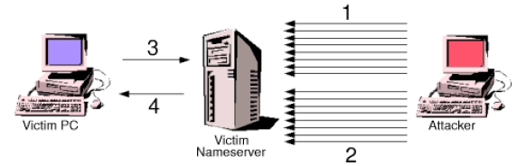
Graphic Explanation of Birthday Attack
Attacker sends a large number of queries to the victim nameserver, all for the same domain name.
Attacker sends spoofed replies giving fake answers for the queries it made
At a later time, victim PC sends a request for the spoofed domain name
Victim nameserver returns fake information to victim PC.

Slide 79
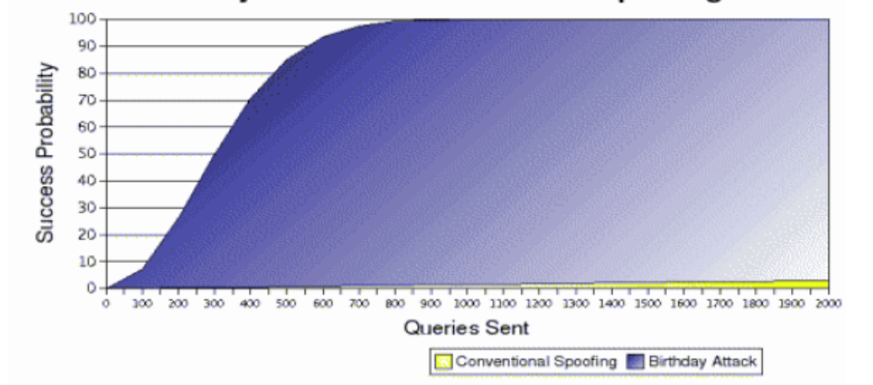
Birthday Attacks vs. Conventional Spoofing

Slide 80
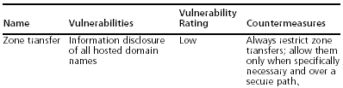
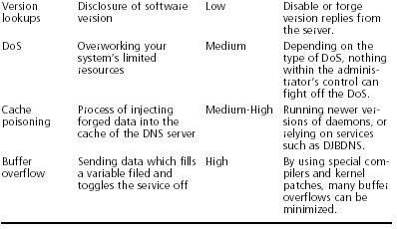
Common Vulnerability Countermeasures

Slide 81
Other More Convenience Tools
host
Sam Spade
axfr

Slide 82
Determine Mail Exchange (MX) Records
Often in a commercial environment, mail is handled on the same system as the firewall, or at least on the same network; therefore, we can use the host command to get such information.
e.g.
  [bash]$ host tellurian.net
  tellurian.net has address 216.182.1.7
  tellurian.net mail is handled (pri=10) by mail.tellurian.net
  tellurian.net mail is handled (pri=20) by smtp-forward.tellurian.net

Slide 83
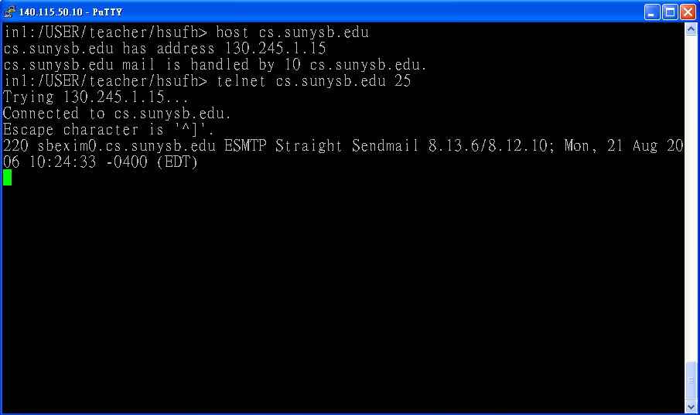
Example of Command host

Slide 84
DNS Security Countermeasure(1)
Restrict Zone Transfer to only authorized servers.
  For modern versions of BIND, use the allow-transfer directive in the named.conf file.
  For Microsoft’s DNS, use the Notify option.

Slide 85
DNS Security Countermeasure (2)
On the network side, you could configure a firewall or packet-filtering router to deny all unauthorized inbound connections to TCP port 53. Because name lookup request are UDP and zone transfer requests are TCP. The above strategy will effectively thwart a zone-transfer attempt.
However the above method violates the RFC which states that DNS queries greater than 512 bytes will be sent via TCP (P.S.: most DNS queries will easily fit within 512 bytes.)

Slide 86
DNS Security Countermeasure (3)
A better solution would be to implement cryptographic transaction signatures (TSIGs) to allow only trusted hosts to transfer zone information.
  E.g. for detailed information on TSIG security in Bind 9, see http://www.linux-mag.com/2001-11/bind9_01.html

Slide 87
DNS Security Countermeasure (4)
Restricting zone transfer will increase the time necessary for attackers to probe for IP addresses and hostnames. However, because name lookups are still allowed, attackers could manually perform reverse lookups against all IP addresses for a given net block.
Therefore, you should configure external nameservers to provide information only about systems directly connected to the Internet. External nameservers should never be configured to divulge internal network information. (The authors have seen misconfigured nameservers that allowed them to pull back more than 16,000 internal IP addresses and associated hostnames)

Slide 88
DNS Security Countermeasure (5)
Avoid using HINFO records in DNS servers.

